Slide 1









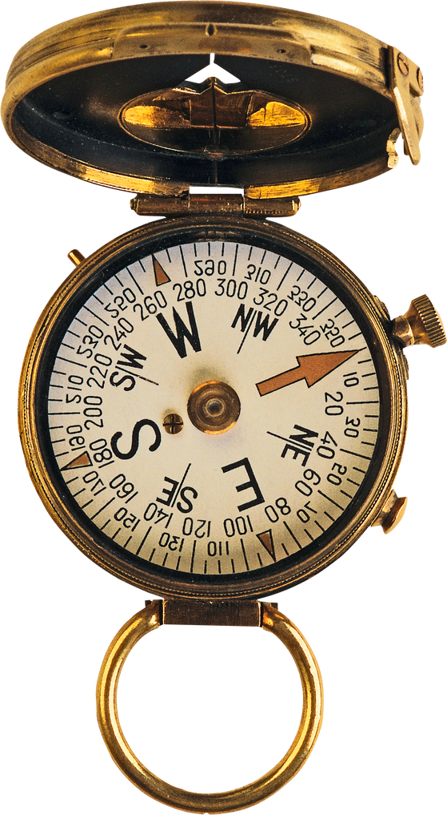




Communication 2
Lesson1: Go to the movie
Lesson 2: Discuss effects of violence on TV views

Slide 2

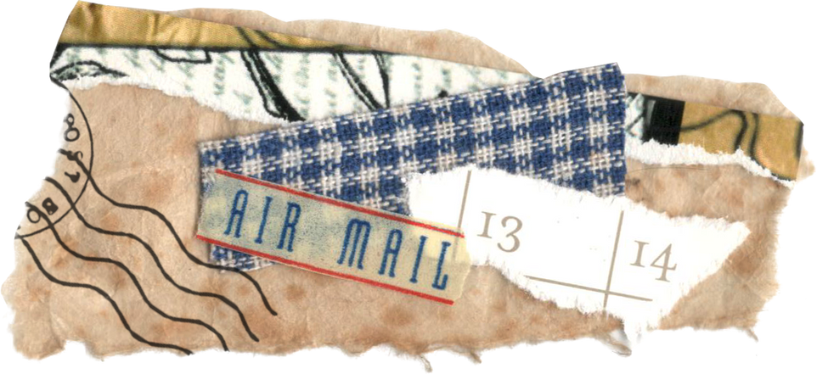






Objectives of the lesson
vocabulary
grammar
•Movie genres
•Adjective to describe the movie
Ways to express wants and preferences (would like and would rather)
Reading
Speaking
Discuss effects of violence on viewers
Talk about your favorite movie

Slide 3


Movie
Notes:
https://www.youtube.com/watch?v=f02Haxdg7EQ

Slide 4

What is the name of movie?
Fast and furious 9
What kind of the movie is it?
Action movie
When was it released?
2021
What is the main actor's name?
Dom Vin Diesel

Slide 5
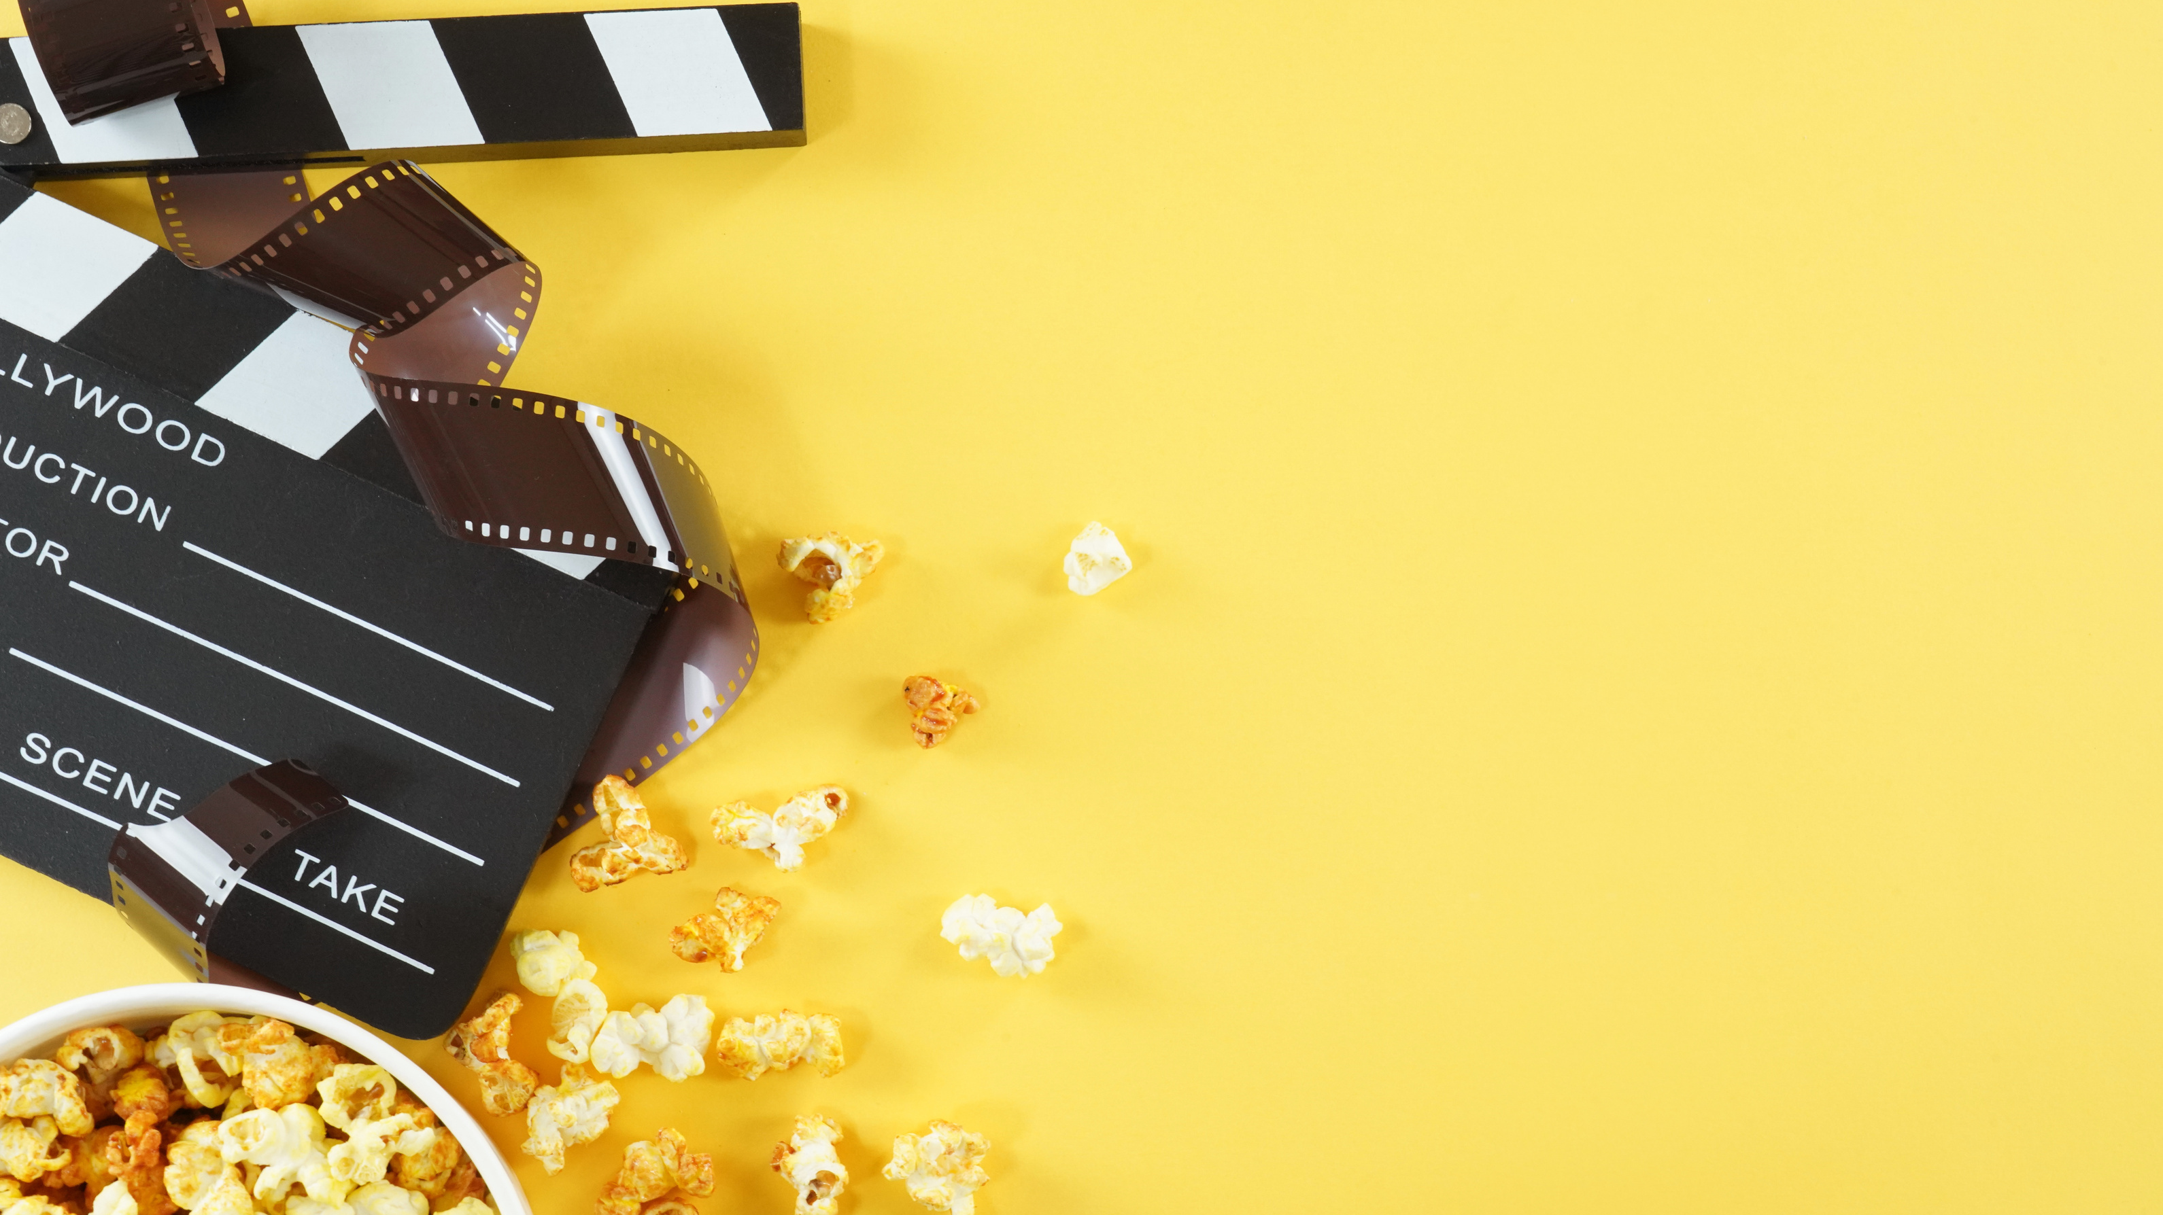
Groupwork – 2 minutes
Can you name some movie genres?

Slide 6

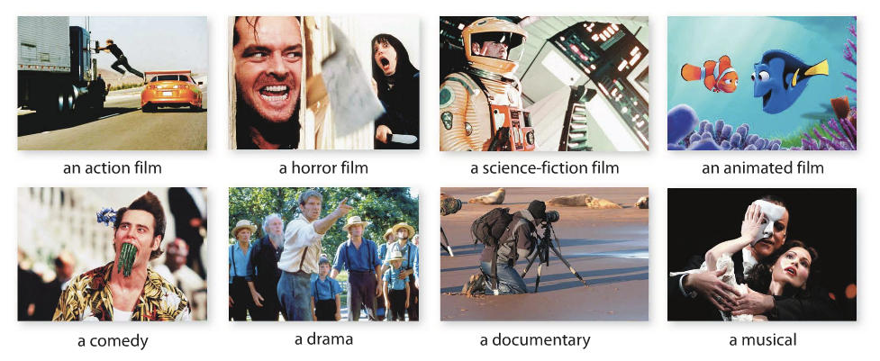

Vocabulary - Movie genres
Read and listen. Then listen and repeat – 5 minutes
CAN YOU GUESS…
Action film
Horror film
Science-fiction film
Animated film
A comedy
drama
doccumentary
mucial

Slide 7
VOCABULARY: Movie genres
Group work: Match each movie genre with the correct description. Write the letter on the line. (5 minutes)
1 | _______ | feature fast-paced, exciting, and dangerous situations | a. | dramas
2 | _______ | are drawn by hand or created on a computer | b. | documentary
3 | _______ | tell a story with singing and dancing | c. | science-fiction films
4 | _______ | give us information about real people and things | d. | action films
5 | _______ | usually take place in the future | e. | animated films
6 | _______ | make us smile and laugh. | f. | musicals
7 | _______ | Focus on characters' problems and emotions | g. | comedies
d
e
f
b
c
g
a

Slide 8


Pair work: Ask and answer the question below - 2 minutes
What’s your favorite movie genre?
Well, my favorite movie genre is a comedy because it makes me smile and laugh
What about you?
Well, my favorite movie genre is a musical because it makes me excited , and relaxed
Useful language
happy
relaxed
pleased
excited
scared
frightened
great

Slide 9


Adjectives to describe the movie
Work in group and guess adjectives to describe the movie based on description (2 minutes)
something that makes you laugh.
very, very funny
not serious, almost stupid
not interesting
about love
very strange or unusual, in a negative way
something you are going to remember
something that makes you think
bloody; with a lot of fighting and killing
funny
hilarious
silly
boring
romantic
weird
unforgettable
thought-provoking
violent

Slide 10

Pair work: Ask and answer the question below (5 minutes)
A: What is your favorite movie? And what movie genre is it?
B: Well, I am a big fan of movies and the movie I am really keen on is..... , and its genre is …...
A: How is the movie?
B: It is …...............................
Useful language
happy
relaxed
pleased
excited
scared
frightened
great

Slide 11




WOULD YOU LIKE TO SEE THE MOVIE AT THE THEATER?
Yes, I would. I would like to see movies at the cinema because it is interesting.
GRAMMAR

Slide 12
WOULD LIKE TO + V
TO EXPRESS WANTS
I would like to see movies at the cinema because it is interesting.
Pair work: Make sentences with the verbs below (2 minutes)
Watch / see
eat
drink
stay at
GRAMMAR

Slide 13
WOULD RATHER + V
To express a preference for an activity.
Would you rather see an animated film or an action film?
→I would rather see an animated film, but I would rather not see an action film.
Grammar
Group work: Make sentences (affirmative and negative) with the verbs below (2minutes)
drink ; eat, see, watch, go

Slide 14

GRAMMAR PRACTICE – WOULD RATHER OR WOULD LIKE
1. A: (Would / Do) you like to go to the theatre tonight?
B: No, I would not. I’d rather (go / going) to the cinema.
2. A: Would you (rather/like) see the new film of Tom Cruise with me?
B: Yes, I (would/do).
3. A: What would you (rather/like) see, a drama or a comedy?
B: Me? I (rather/would rather) see a comedy.
4. A: I (would like/would) to go out tonight. Why don’t you ask your husband to come with us?
B: No, he would rather (stay/stays) at home and watch TV.
5. A: My wife (would like/would like to) go shopping tonight.
B: Great! My wife (would/would like), too.
Grammar

Slide 15
Discuss effects of violence on viewers

Slide 16

Groupwork: Discussion – 5 minutes
1. Can children watch this movie? Why or why not?
2. At what age can they watch this movie? (16 + ; 18+)
Useful language
hilarious
funny
fast-paced
violent
aggressive
less sensitive
harmful

Slide 17
Vocabulary
Pair work: Check your dictionary to find its meaning - 5 minutes
violence (n) violent (a) : an action to hurt or kill somebody
aggressive (a) : angry and ready to attack
commit (v) : to do something wrong or illegal
encourage (v) : to give somebody support
consequence (n) : an unpleasant result of something that has happened
Punishment (n) : an act or a way of punishing somebody

Slide 18

2 minutes
1
3
2
Notes:
FOCUS ON PARTS 1;2;3

Slide 19
Understand from the context Group work: Circle the correct word or phrase to complete each statement, according to the information in the article. - 5 minutes
(a realistic / an aggressive) person is someone who is likely to fight with others.
Scientific studies have reported that some kinds of movies and TV programs can (limit / encourage) aggressive behavior.
One kind of violent crime is (murder / bad behavior).
A word that means almost the same thing as hurt is. (help / harm).
It is difficult to (permit / prevent) older children from seeing any violence on TV and in movies.
Research has supported that (a consequence / an advantage) of watching violent films is aggressive behavior.

Slide 20
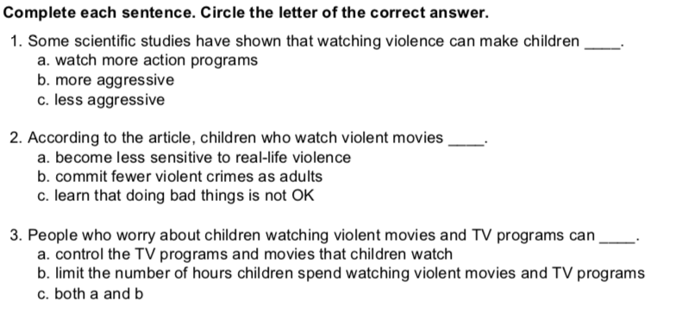
Groupwork: 2 minutes

Slide 21




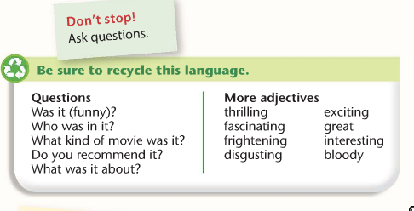


Group work: Write and describe the movie (15 minutes)
Genre:
Stars:
Director or producer:
Adjectives that describe the movie:
What is the movie about? :
Can children watch the movie?:
What did you learn from the movie?:

Slide 22



CONSOLIDATION
WHAT HAVE WE LEARNT TODAY?
1. Movie genres
2. Adjectives to describe the movie
3. Ways to express wants and preferences (would like and would rather)
4. Discuss effects of violence on viewers
5. Talk about your favorite movie

Slide 23
Topic 2
Talk about your favorite movie

Slide 24
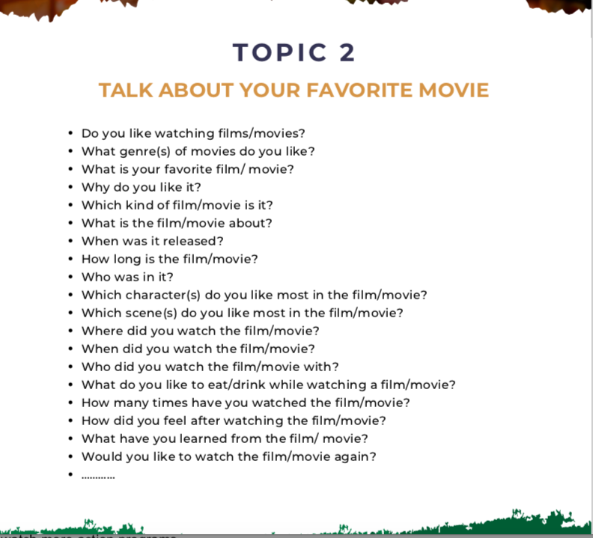

Slide 25
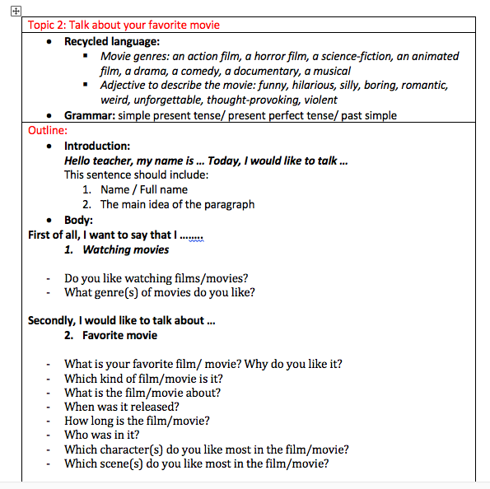
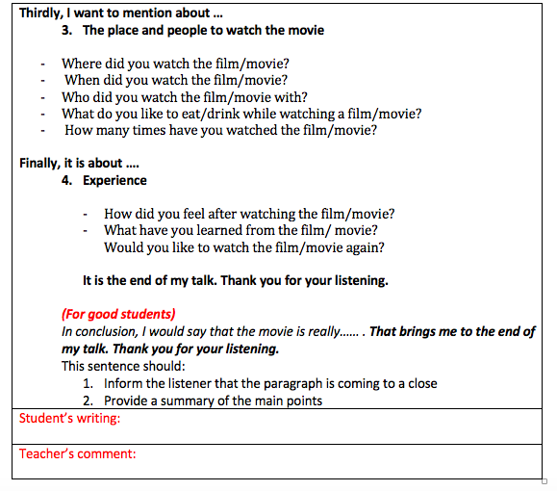
Writing format

Slide 26

Thank you!

